Slide 1
Office 365 Development

Slide 2
Xamarin Development with Office 365 APIs in Visual Studio 2013
Speaker
Speaker

Slide 3

Agenda
Xamarin Development Overview
Developing Xamarin Apps
Developing for Office 365
Creating Shared Projects

Slide 4
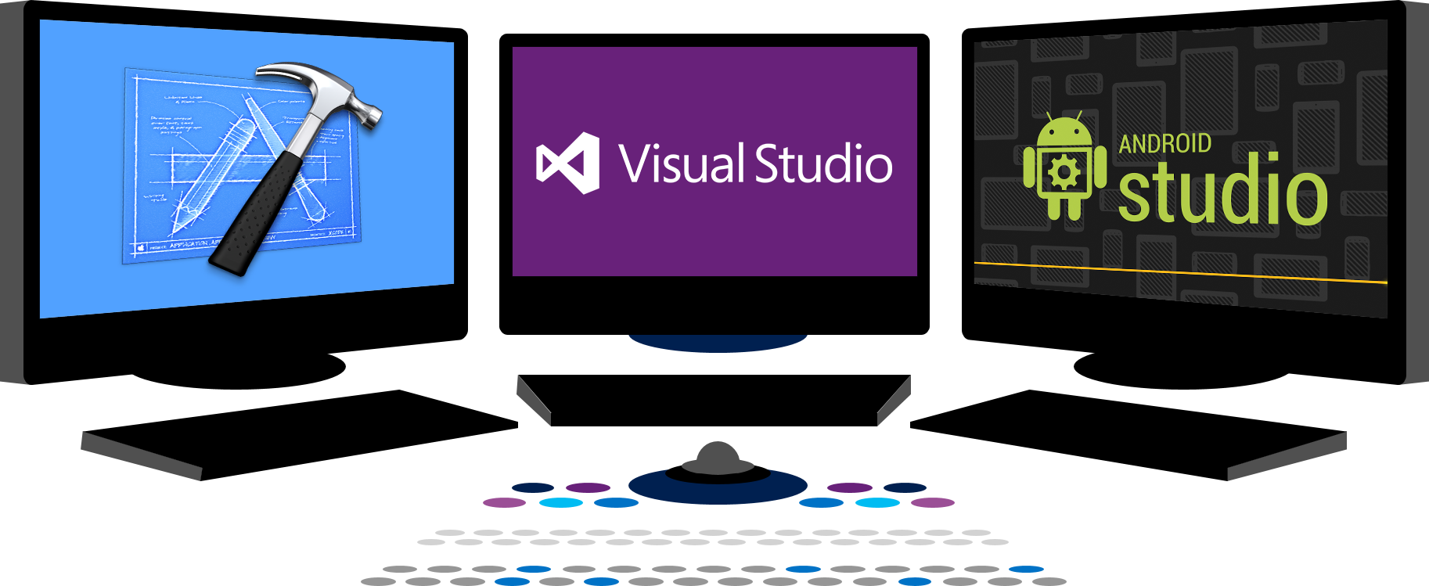














Vision
EXTEND OFFICE EVERYWHERE
CONNECT TO OFFICE 365 SERVICES
BUILD USING AN OPEN PLATFORM
Delve
z
Users and groups
Files
Mail
Calendar
My Apps
Video Portal
Contacts
Office Graph
Presentations
Documents
Spreadsheets
Lync
OneNote
Yammer

Slide 5
Xamarin Development Overview

Slide 6
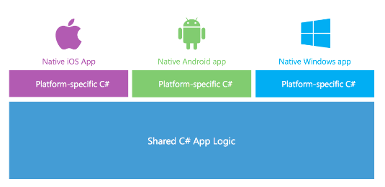
What is Xamarin?
A Company and a Development Platform
Developing on Xamarin platform requires monthly or yearly subscription
You can get a free 30-day trial (90-day trial available for MSDN subscribers)
Xamarin Development based on the .NET framework
You write code using C# and the .NET framework class libraries
Xamarin Platform supported across many OSs and devices
Android
iOS and Mac
Windows and Windows Phone

Slide 7
.NET on Android and iOS
CLR and .NET created for Windows
CLR ported to Linux with Mono project
Mono extended to Android and iOS
iOS
MonoTouch
Windows OS
Linux
CLR & .NET
Mono
CLR & .NET
Android
Mono for Android

Slide 8
Evolution of the Xamarin Platform
Xamarin Platform’s Key Value Proposition
Provide update-to-date versions of .NET on Xamarin.iOS and Xamarin.Android
Allow you to leverage skills you already have with Visual Studio, C# and .NET
Support latest C# features such as support for async and await
iOS
iOS
MonoTouch
Xamarin.iOS
Linux
Mono
CLR & .NET
Android
Android
Mono for Android
Xamarin.Android

Slide 9
What Problems does Xamarin Solve?
Let’s compare Android, iOS and Windows Phone
Significant differences in toolsets
Significant differences in UI/UX models
Significant differences in execution models
Bringing.NET platform to Android and iOS is difficult
Android and iOS platforms have unique runtime environments
Environments very different from .NET’s Common Language Runtime (CLR)
Environments for Android and iOS significantly difference from each other

Slide 10
Xamarin on Android Architecture
App
.NET APIs
Android
Bindings
MCW
android.*
java.*
Mono Runtime
ACW
Dalvik Runtime
Android Kernel

Slide 11
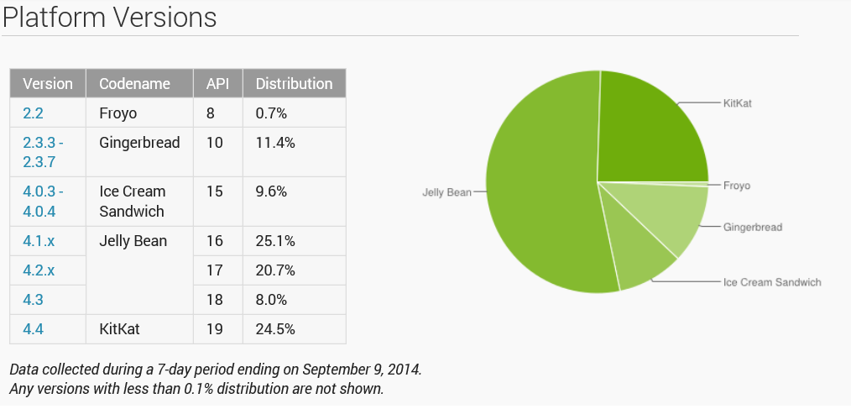
Android usage statistics from http://developer.android.com/about/dashboards/index.html

Slide 12
Xamarin on iOS Architecture
Apple does not allow for runtimes on iOS
App must be packages with everything it needs to run on iOS
Compilation of app must be done on computer with iOS not Windows
App
Application Code
.NET APIs
iOS
Bindings
iOS

Slide 13
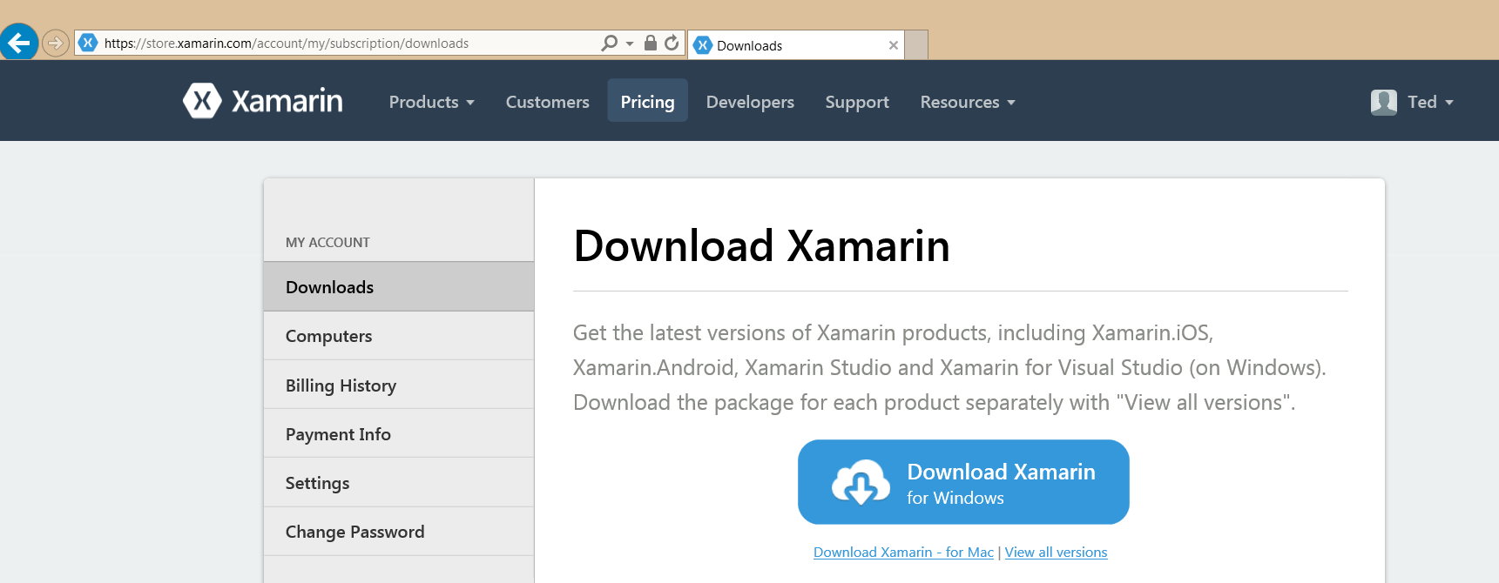
Xamarin Setup
Visual Studio 2013 with Update 3
Install Xamarin

Slide 14
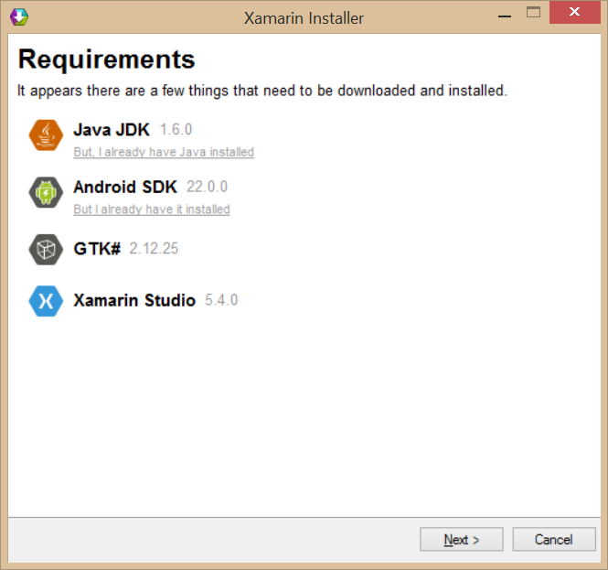
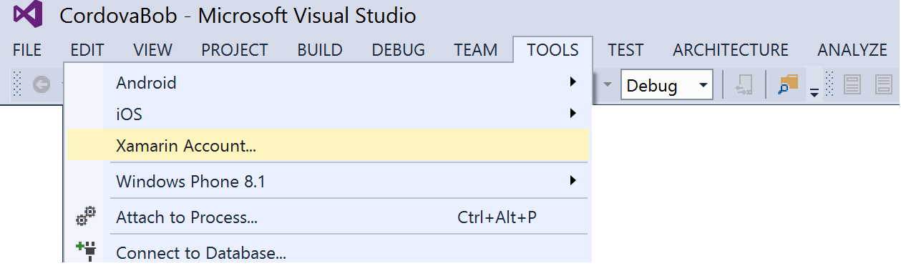
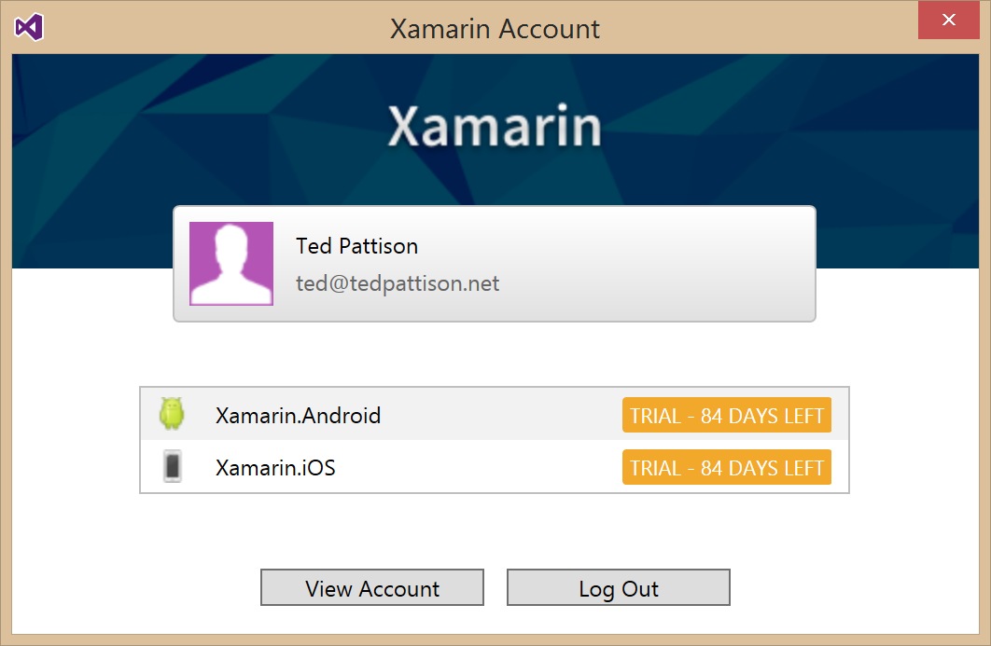
Xamarin Installer
What does it install?
Integration support into Visual Studio
Java JDK
Android SDK
GTK# (UI Toolkit for mono and .NET)
Xamarin Studio

Slide 15
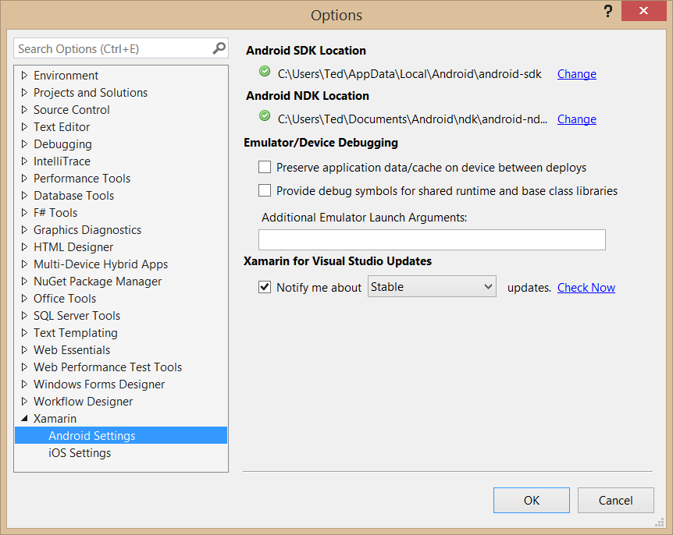
Tools > Options > Xamarin

Slide 16
Developing Xamarin Apps

Slide 17
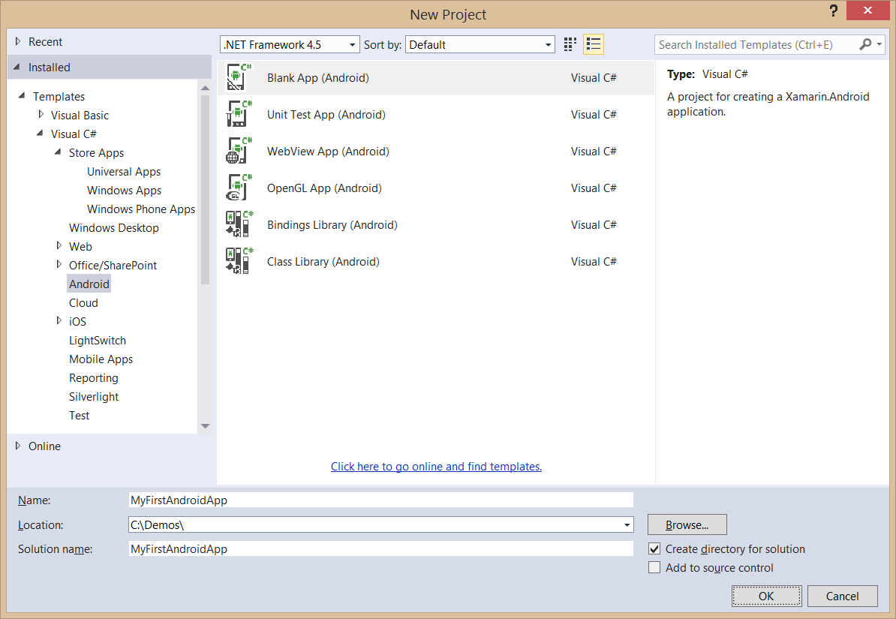
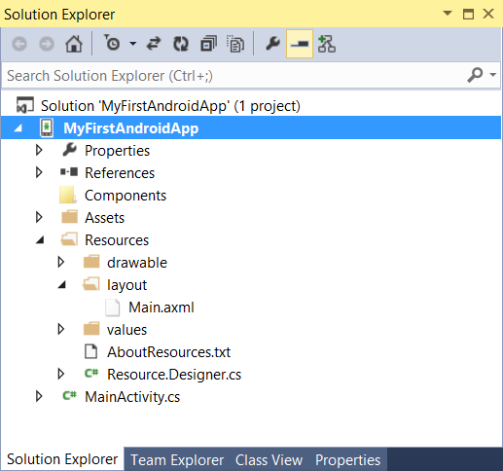
Creating an Android App Project

Slide 18
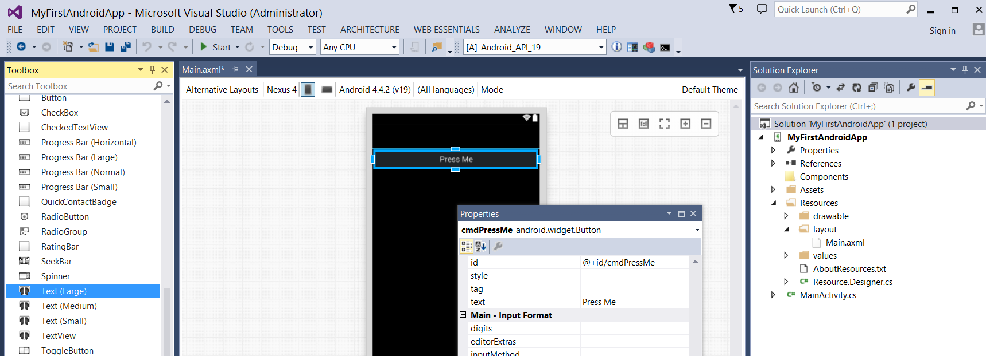
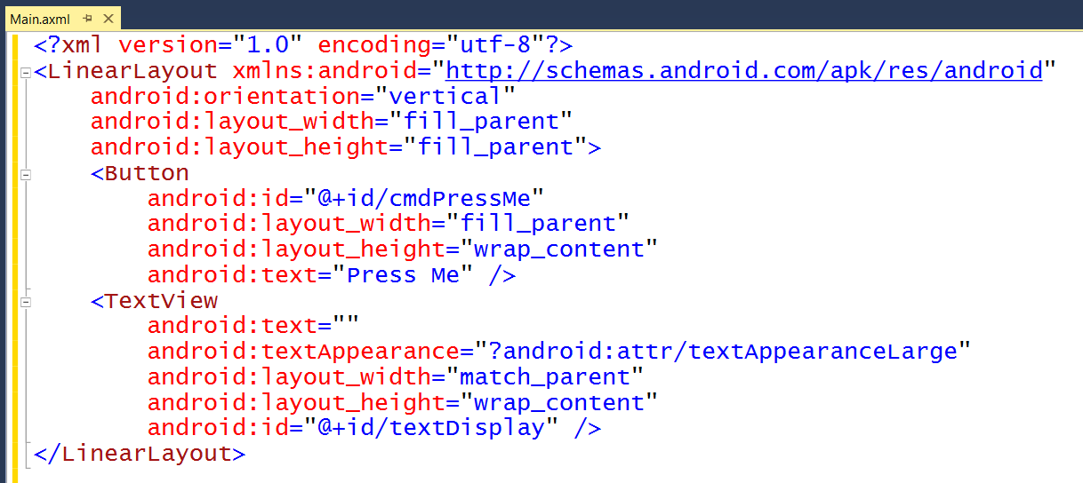
Android Layouts
UI layout decoupled from UI management code
UI Layouts created in XML-based resource files with .axml extensions
Xamarin adds Android layout design editor into to Visual Studio

Slide 19
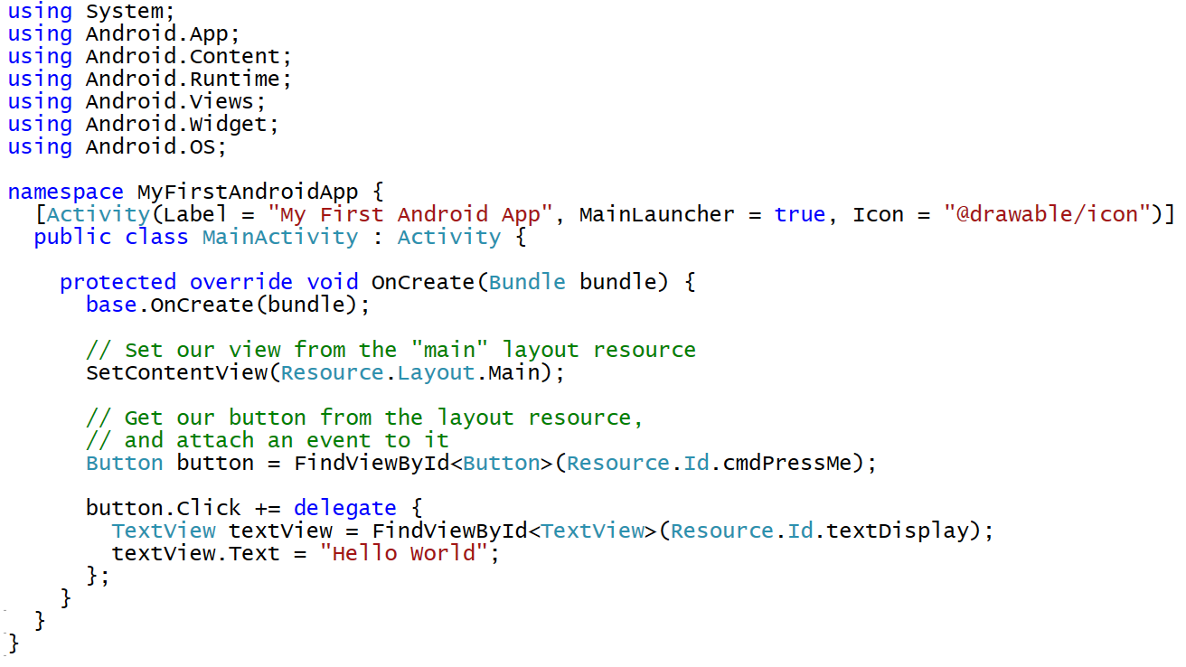
Activity-based User Interface Code

Slide 20
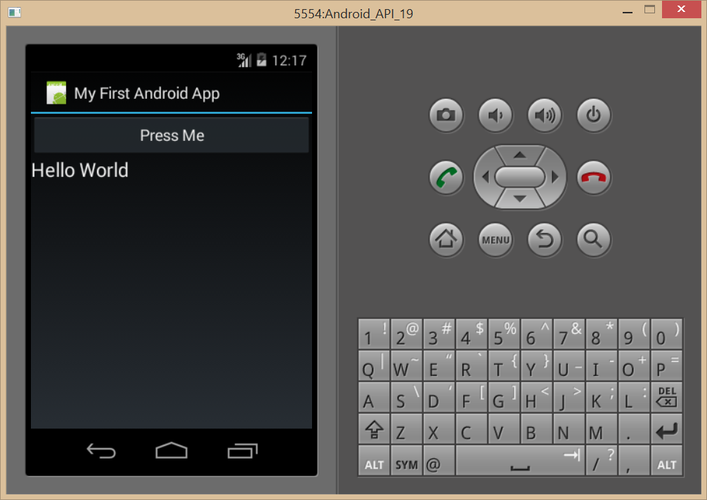
Debugging with an Android Emulator
Android emulators created with Android SDK can be slow
You can optimize performance by installing the Intel HAX module
Intel HAX module requires disabling Hyper-V
http://serena-yeoh.blogspot.com/2014/02/boost-performance-of-android-emulator.html
Use 3rd party emulator such as Genymotion

Slide 21
demo
Creating and Testing an Android App using Xamarin

Slide 22
Developing for Office 365

Slide 23
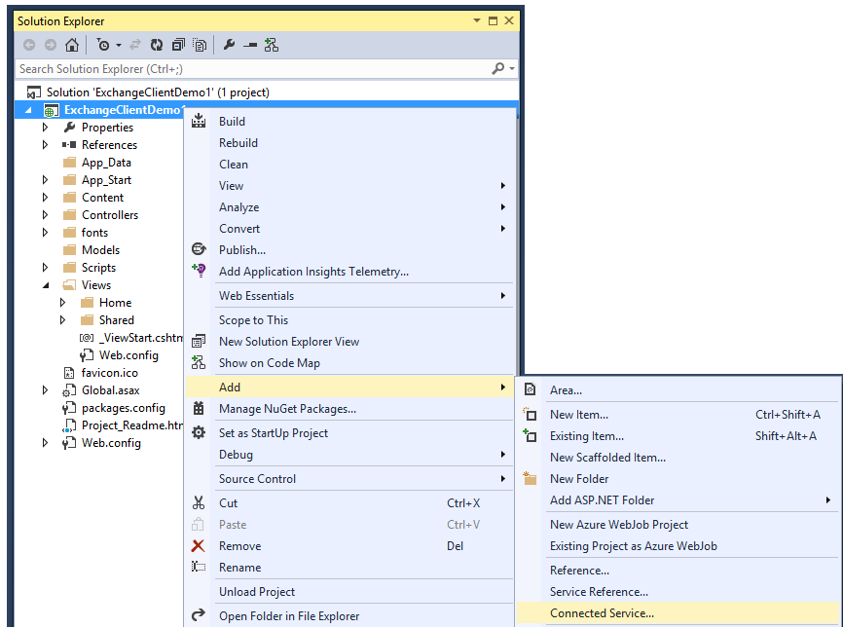
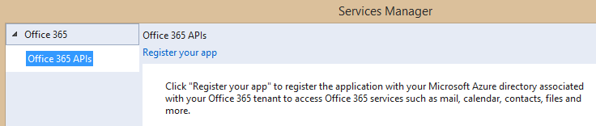
Adding Connected Services
1
Project > Add > Connected Service…
2
Register your app

Slide 24
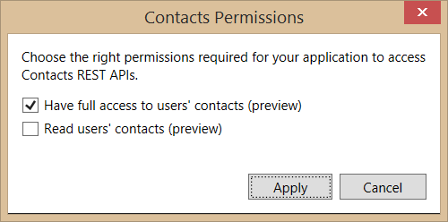
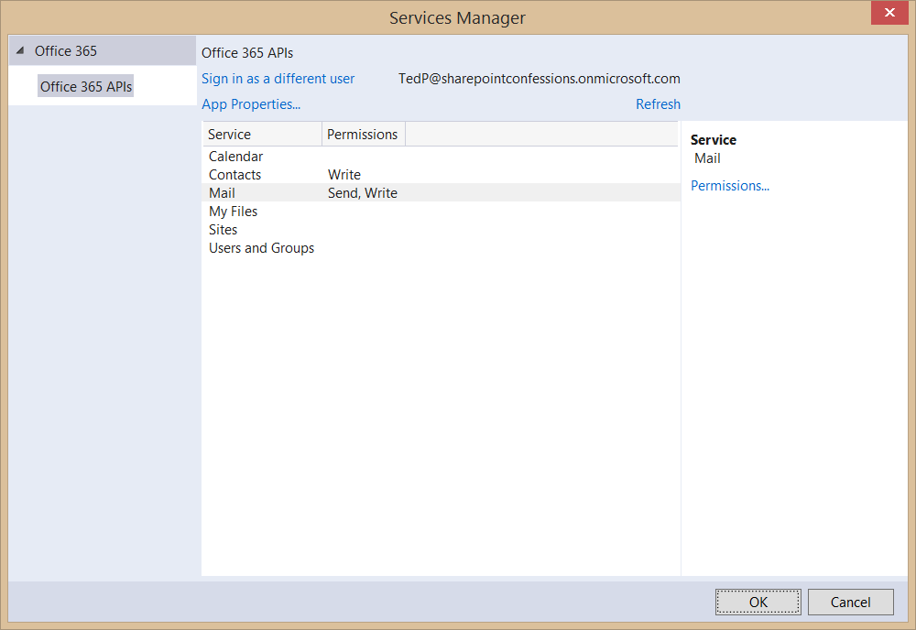
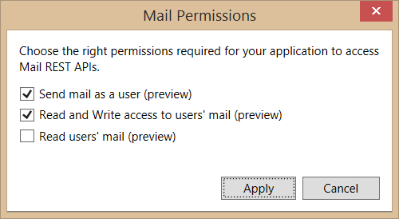
Connected Services Permissions
3
Select required app permissions

Slide 25
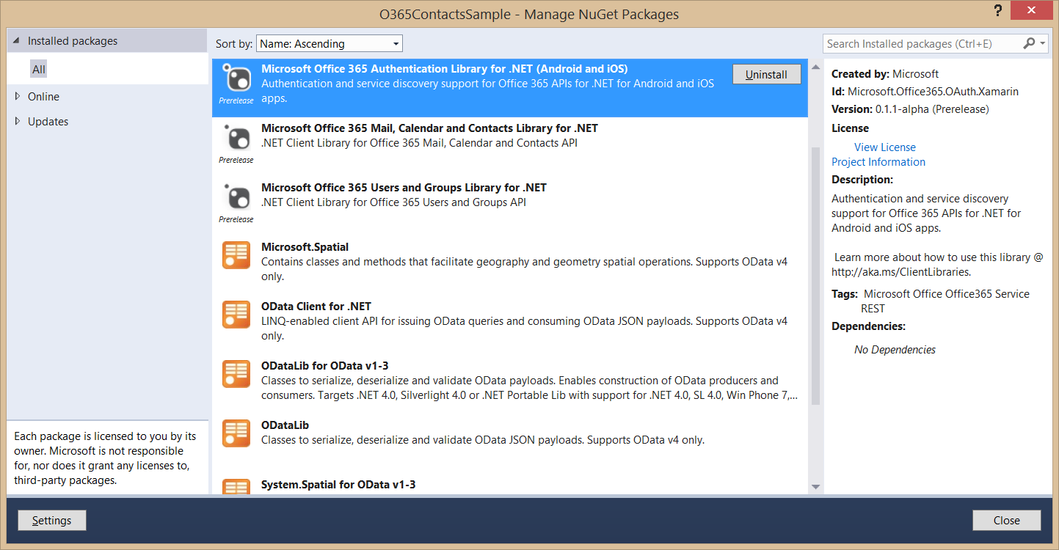
Nuget Packages Added with Connected Services
These packages are added to project when adding a Connected Service

Slide 26
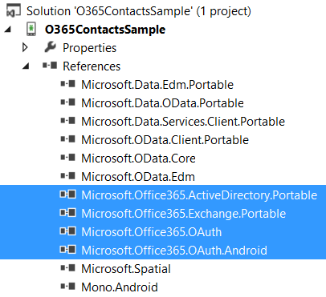
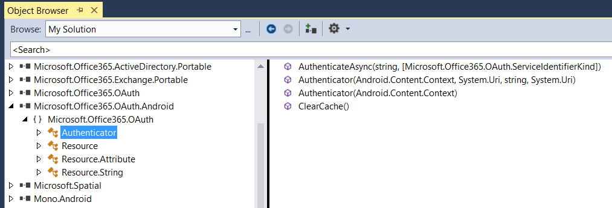
Assemblies Added with Connected Services
These assemblies are added to project when adding a Connected Service

Slide 27
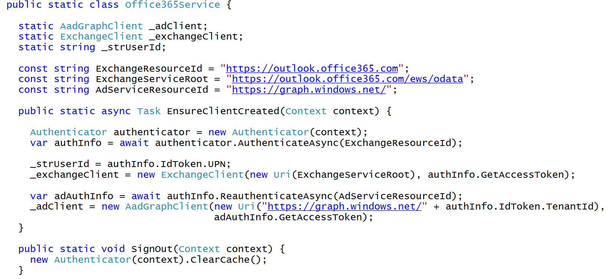
C# Code to Authenticate the User

Slide 28
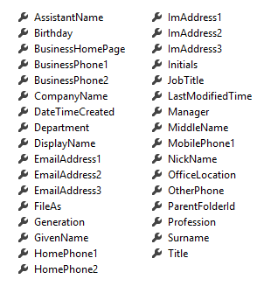
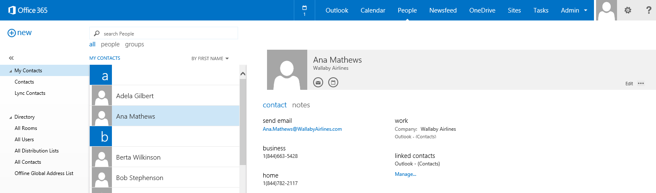
Office 365 Contacts
Common API operations
Reading contacts
Searching for contacts
Creating contacts
Deleting contacts
Editing events
Contact

Slide 29
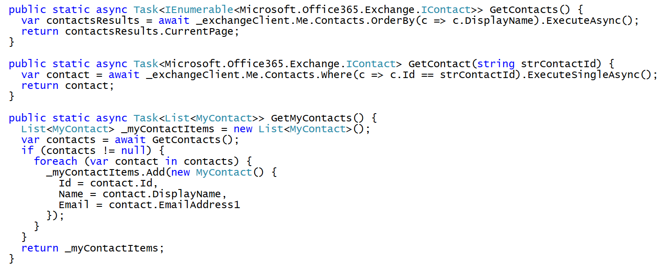
Programming with Office 365 Contacts

Slide 30
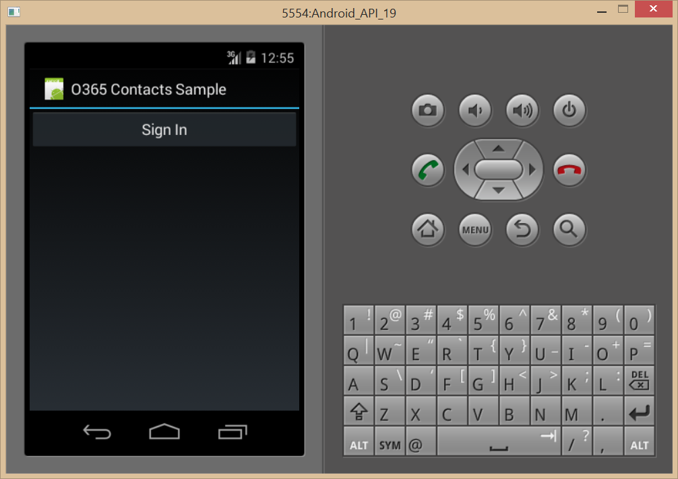
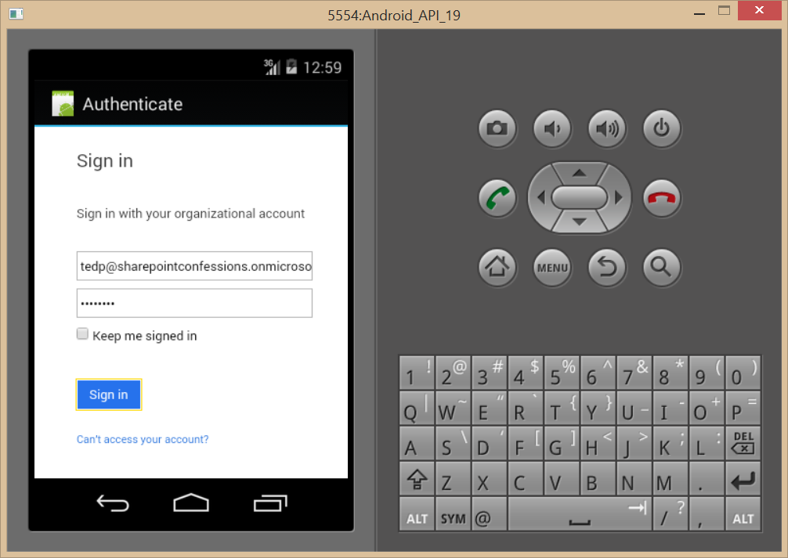
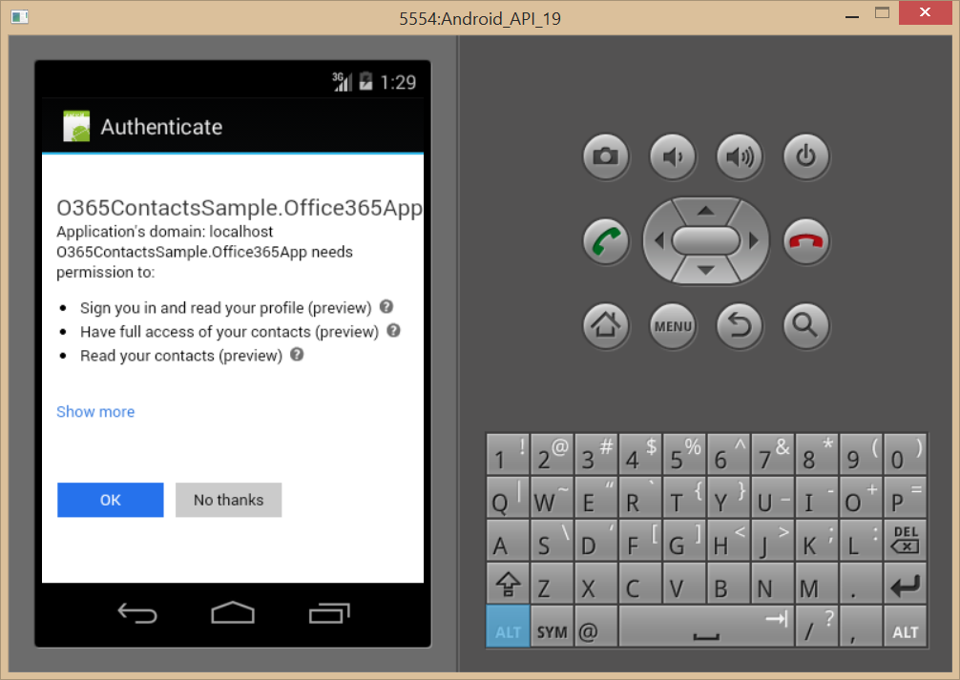
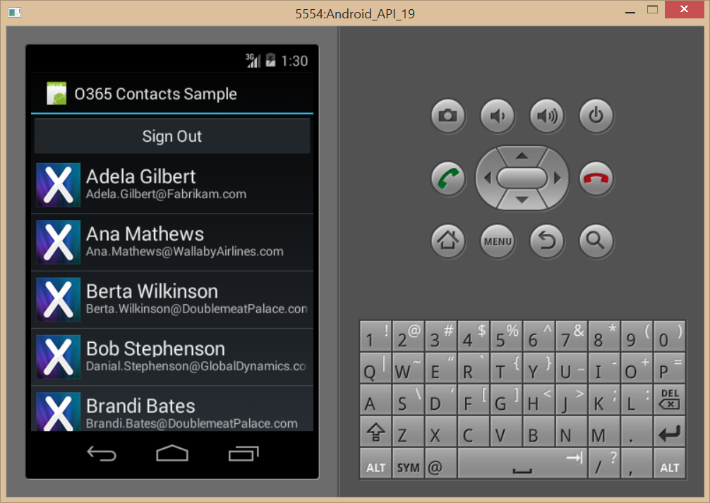
Authentication Flow

Slide 31
demo
Adding A Connected Service to a XAMARIN App

Slide 32
Creating Shared Projects

Slide 33
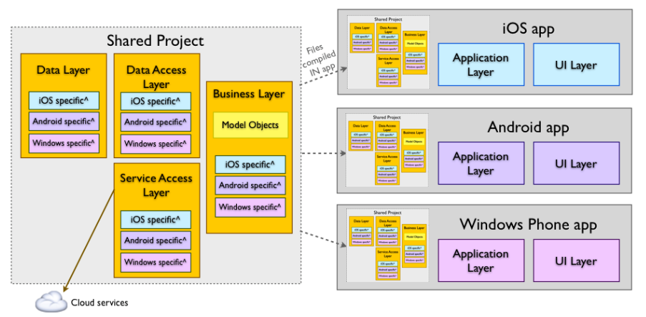
Shared Projects
Allows for reuse of code across projects
Shared project has no output (e.g. DLL) of its own
Shared project code is compiled into any other project that reference it

Slide 34
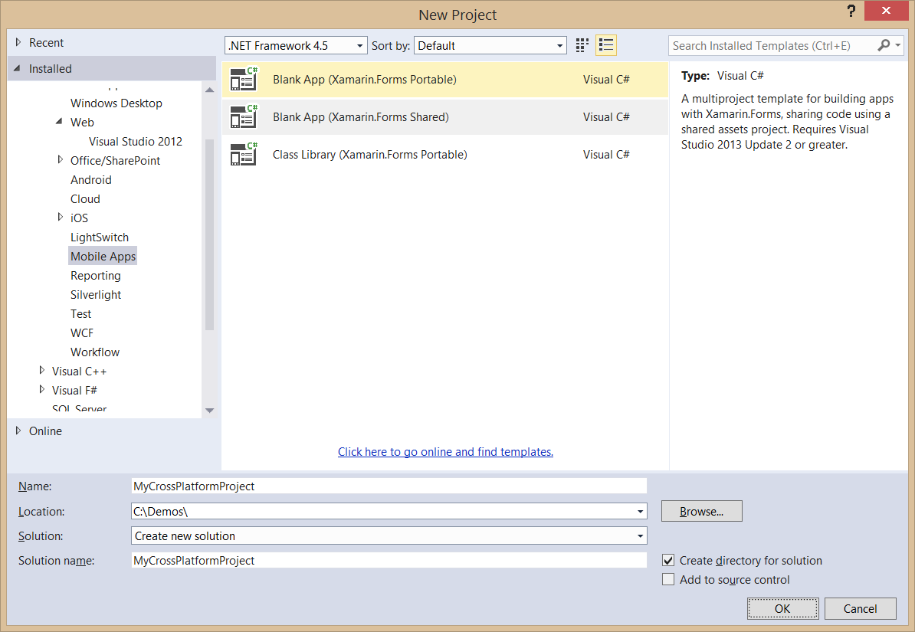
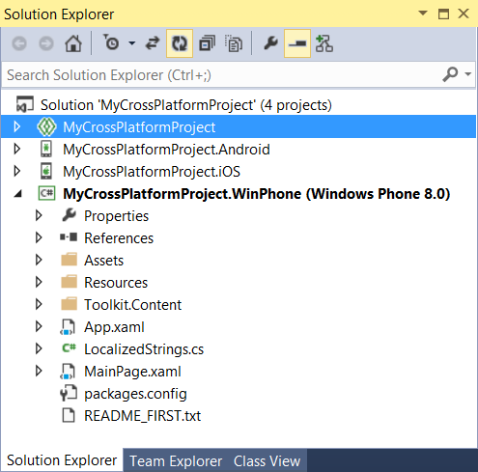
Creating a Shared Project Solution

Slide 35
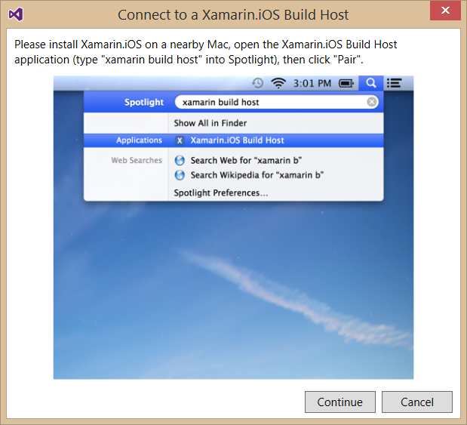
Integrating an iOS Project
To build iOS apps you will needs a Mac
Xamarin product orchestrates communication between Mac and Windows
Windows PC with Visual Studio pairs with Mac computer
Builds and debugging sessions can be initiated from Visual Studio
App compilation done on the Mac

Slide 36
Xamarin.Forms
Cross-platform natively backed UI toolkit abstraction
Allows for UI layouts that can be shared across Android, iOS, and Windows Phone
User interfaces are rendered using the native controls of the target platform
Allows applications to retain the appropriate look and feel for each platform

Slide 37
demo
Examining a Xamarin Cross-Platform Solution

Slide 38
Summary
Xamarin Development Overview
Developing Xamarin Apps
Developing for Office 365
Creating Portable Xamarin Apps

Slide 39



Building skills
Add screens shot from link
Microsoft Virtual Academy
dev.office.com/training
Code Samples
dev.office.com/code-samples
DX Office 365 Dev Camps
Office 365 Summit Developer Tracks
summit.office.com

Slide 40

Make look cool
Developer Patterns & Practices
Transform your code
Providing App Model Patterns for common SharePoint Full Trust Code and Office Add-in scenarios
60+ Visual Studio projects
Common scenarios Branding Site provisioning Remote event receivers
Large file support Taxonomy driven navigation And much more… aka.ms/OfficeDevPnP

Slide 41
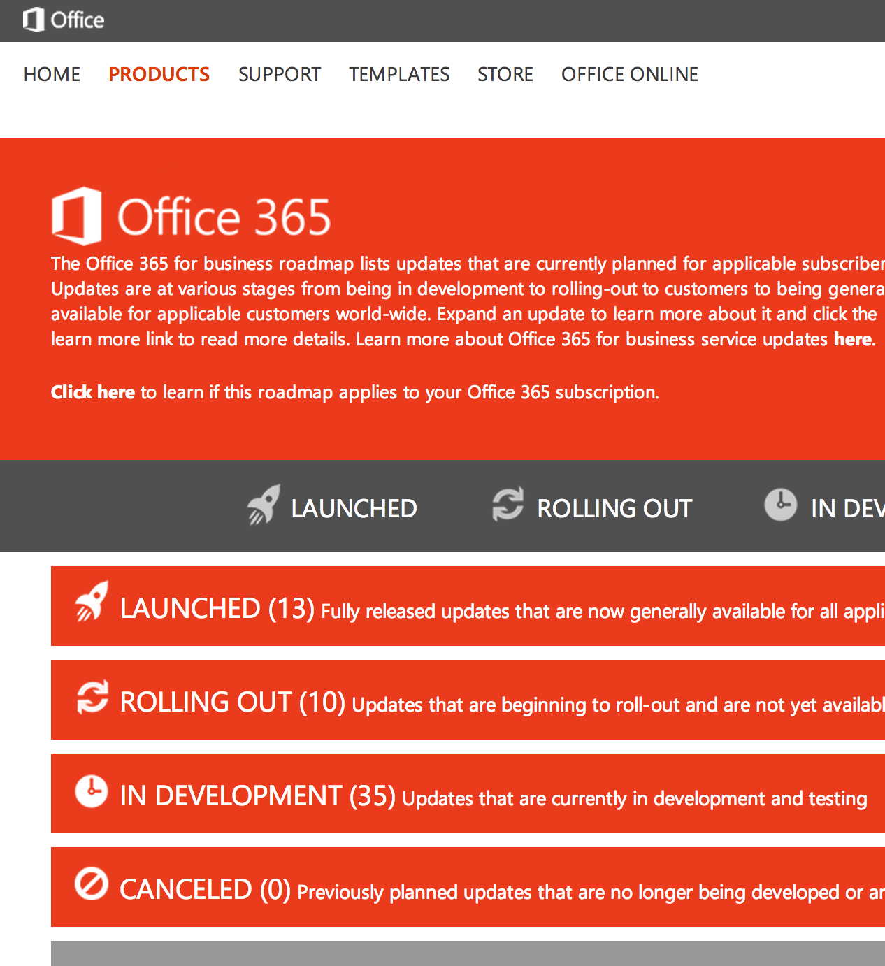
Roadmap
Monthly updates
Associated blog posts
www.office.com/roadmap

Slide 42
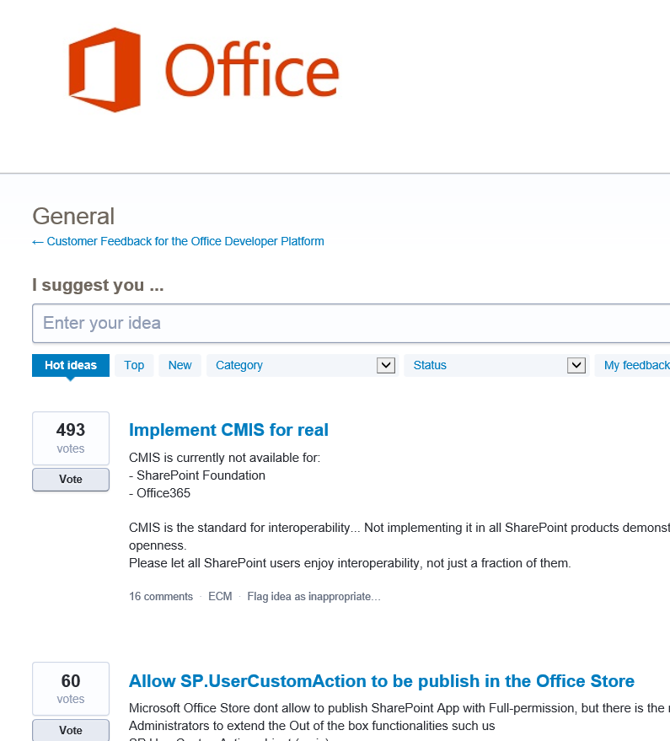

Customer feedback
Yammer Office 365 Technical Network
Stackoverflow
UserVoice Developer focused Bi-weekly triage Link to roadmap to show actions
http://aka.ms/OfficeDevFeedback

